Slide 1
Lecture 34: Church Turing Thesis and Halting Problem
Agenda:
Church Turing Thesis
Halting Problem
Presented by
Prof. Vaibhav Narayan Chunekar
K. J. Somaiya College of Engineering, Vidyavihar, Mumbai
KJSCE

Slide 2
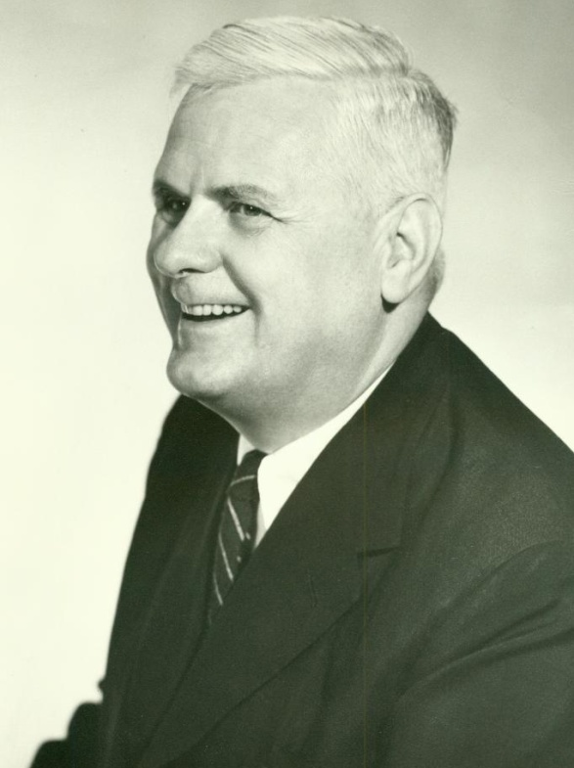
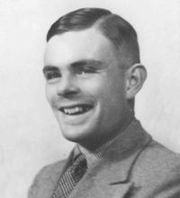
Church-Turing Thesis
Alonzo Church (1903-1995)
Alan Turing (1912-1954)
Reminder: PS4 is due Tuesday
cs302: Theory of Computation
University of Virginia
Computer Science
David Evans
http://www.cs.virginia.edu/evans

Slide 3
Menu
Finish computing model for TM
The Most Bogus Sentence
Robustness of TM Model (Church-Turing Thesis)

Slide 4
Turing Machine
. . .
FSM
Infinite tape: Γ*
Tape head: read current square on tape,
write into current square,
move one square left or right
FSM: like PDA, except:
transitions also include direction (left/right)
final accepting and rejecting states

Slide 5
Turing Machine Formal Description
. . .
FSM
7-tuple: (Q, Σ, Γ, δ, q₀, q_{accept}, q_{reject})
Q: finite set of states
Σ: input alphabet (cannot include blank symbol, _)
Γ: tape alphabet, includes Σ and _
δ: transition function: Q × Γ → Q × Γ × {L, R}
q₀: start state, q₀ ∈ Q
q_{accept}: accepting state, q_{accept} ∈ Q
q_{reject}: rejecting state, q_{reject} ∈ Q
(Sipser’s notation)

Slide 6
Turing Machine Computing Model
Initial configuration:
x∈Σ
x
x
x
x
x
x
x
_
_
_
_
. . .
blanks
input
FSM
q₀
TM Configuration: Γ* × Q × Γ*
tape contents
left of head
current
FSM state
tape contents
head and right

Slide 7
TM Computing Model
δ*: Γ* × Q × Γ* → Γ* × Q × Γ*
The q_{accept} and q_{reject} states are final:
δ*(L, q_{accept}, R) → (L, q_{accept}, R)
δ*(L, q_{reject}, R) → (L, q_{reject}, R)

Slide 8
TM Computing Model
δ*: Γ* × Q × Γ* → Γ* × Q × Γ*
u, v ∈ Γ*, a, b ∈ Γ
a
b
. . .
u
FSM
v
q
δ*(ua, q, bv) = δ*(uac, q_{r}, v) if δ(q, b) = (q_{r}, c, R)
δ*(ua, q, bv) = δ*(u, q_{r}, acv) if δ(q, b) = (q_{r}, c, L)
Also: need a rule to cover what happens at left edge of tape

Slide 9
TM Computing Model
δ*: Γ* × Q × Γ* → Γ* × Q × Γ*
u, v ∈ Γ*, a, b ∈ Γ
a
b
. . .
u
FSM
v
q
δ*(ua, q, bv) = δ*(uac, q_{r}, v) if δ(q, b) = (q_{r}, c, R)
δ*(ua, q, bv) = δ*(u, q_{r}, acv) if δ(q, b) = (q_{r}, c, L)
δ*(ε, q, bv) = δ*(ε, q_{r}, cv) if δ(q, b) = (q_{r}, c, L)
Do we need a rule for the right edge of the tape?

Slide 10
TM Computing Model
δ*: Γ* × Q × Γ* → Γ* × Q × Γ*
A string w is in the language of Turing Machine T if
δ*(ε, q₀, w) = (α, q_{accept},β)
A string w is not in the language of Turing Machine T if
δ*(ε, q₀, w) = (α, q_{reject},β)
Does this cover all possibilities?

Slide 11
Termination
DFAs, DPDAs:
  Consume one input symbol each step
  Must terminate
NFAs:
  Equivalent to DFA: must terminate
Turing Machine:
  Can move left and right: no “progress” guarantee

Slide 12
Possible Outcomes
Running TM M on input w eventually leads to q_{accept}.
Running TM M on input w eventually leads to q_{reject}.
Running TM M on input w runs forever (never terminates).

Slide 13
Recognizing vs. Deciding
Turing-recognizable: A language L is “Turing-recognizable” if there exists a TM M such that for all strings w:
  If w ∈ L eventually M enters q_{accept}
  If w ∉ L either M enters q_{reject}
  or M never terminates
Turing-decidable: A language L is “decidable” if there exists a TM M such that for all strings w:
  If w ∈ L, M enters q_{accept}.
  If w ∉ L, M enters q_{reject}.

Slide 14

Decider vs. Recognizer?
Deciders always terminate.
Recognizers can run forever without deciding.

Slide 15
Decidable and Recognizable Languages
Recognizable
Decidable
Do we know this picture is right yet?

Slide 16
The Most Bogus Sentence Guesses
“Intuitive notion of algorithms equals Turing machine algorithms.”
“Some of these models are very much like Turing machines, but others are quite different.”
“Think of these as 'virtual' tapes and heads,” on page 149. The quotation marks around virtual imply that the tapes and heads are not virtual, which is false.
“If you feel the need to review nondeterminism, turn to Section 1.2 (page 47).” (By this point, one should have a firm grasp of nondeterminism.)
“Proving an algorithm doesn't exist requires having a clear definition of algorithm.”
“For mathematicians of that period to come to this conclusion [(Hilbert’s 10th Problem’s accepted solution)] with their intuitive concept of algorithm would have been virtually impossible.”
I don’t find any of these statement bogus.

Slide 17
A bogus sentence (but not the one I had in mind)
“To show that two models are equivalent we simply need to show that we can simulate one by the other.”
Winner: David Horres
A
B
For set equivalence, need to show A ⊆ B and B ⊆ A.
For machine equivalence, need to show
A can simulate B and B can simulate A.

Slide 18
The Most Bogus Sentence
“A Turning machine can do everything a real computer can do.”
On the first page!
Winners: Erin Carson, Emily Lam, Ruixin Yang,

Slide 19

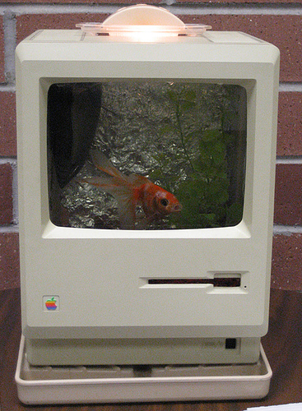

Things Real Computers Can Do
Generate Heat
Provide an adequate habitat for fish
Stop a Door

Slide 20

Computational Thing Most Real Computers Can Do (that Turing Machines can’t)
Generate randomness

Slide 21
Church-Turing Thesis

Slide 22
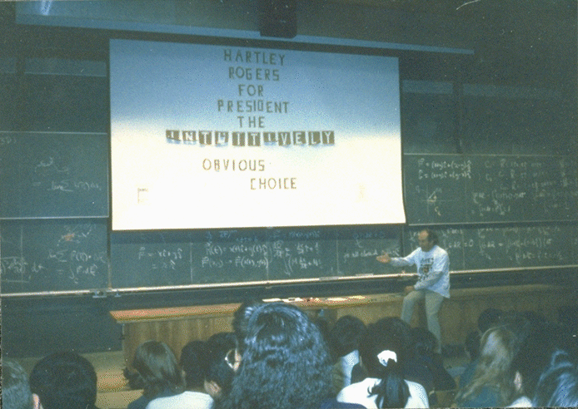
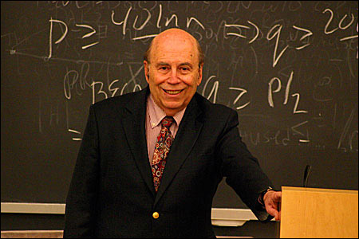
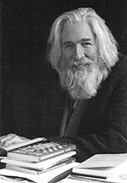

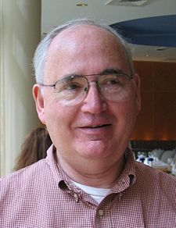

Alonzo Church’s “Less Successful”
PhD Students
Michael Rabin
Hartley Rogers
Raymond Smullyan
Stephen Kleene
John Kemeny
Martin Davis
Dana Scott
See http://www.genealogy.ams.org/id.php?id=8011 for full list

Slide 23
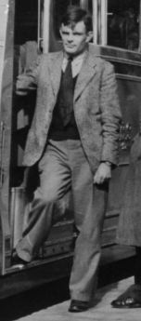
Alan Turing (1912-1954)
Published On Computable Numbers, with an Application to the Entscheidungsproblem (1936)
  Introduced the Halting Problem
  Formal model of computation
  (now known as “Turing Machine”)
Codebreaker at Bletchley Park
  Involved in breaking Enigma Cipher
After the war: convicted of homosexuality (then a crime in Britain), committed suicide eating cyanide apple

Slide 24


Slide 25
Church-Turing Thesis
As stated by Kleene:
  Every effectively calculable function (effectively decidable predicate) is general recursive.
“Since a precise mathematical definition of the term effectively calculable (effectively decidable) has been wanting, we can take this thesis ... as a definition of it...”
Yes, this is circular: everything calculable can be computed by a TM,
and we define what is calculable as what can be computed by a TM.

Slide 26
Church-Turing Thesis
Any mechanical computation can be performed by a Turing Machine
There is a TM-n corresponding to every computable problem
We can model any mechanical computer with a TM
The set of languages that can be decided by a TM is identical to the set of languages that can be decided by any mechanical computing machine
If there is no TM that decides problem P, there is no algorithm that solves problem P.
All of these statements are implied by the Church-Turing thesis

Slide 27
Examples
[Last class and PS4] Equivalence of TM and 2-stack deterministic PDA + ε-transitions
[PS4] Making the tape infinite in both directions adds no power
[Soon] Adding a second tape adds no power
[Church] Lambda Calculus is equivalent to TM
[Chomsky] Unrestricted replacement grammars are equivalent to TM
[Takahara and Yokomori] DNA is at least as powerful as a TM
[Hotly Debated] Is the human brain equivalent to a TM?
“Some of these models are very much like Turing machines, but others are quite different.” (not such a bogus sentence)

Slide 28
Halting Problem
In computability theory, the halting problem is the problem of determining, from a description of an arbitrary computer program and an input, whether the program will finish running, or continue to run forever.
Alan Turing proved in 1936 that a general algorithm to solve the halting problem for all possible program-input pairs cannot exist.

Slide 29

Halting Problem
It is plain at any rate that the real mathematics (apart from the elements) has no direct utility in war. No one has yet found any war-like purpose to be served by the theory of numbers or relativity or quantum mechanics, and it seems very unlikely that anybody will do so for many years.
G. H. Hardy (Turing’s advisor), Mathemetician’s Apology, 1940
By 1943, Turing had used number theory to break the Nazi Enigma code.
CS200: Computer Science
University of Virginia
Computer Science
David Evans
http://www.cs.virginia.edu/evans
KJSCE

Slide 30
Are there any undecidable problems?
The Proof-Finding Problem:
Input: an axiomatic system, a statement S
Output: If S is true, output a valid proof. If S is not true, output false.
KJSCE

Slide 31
Undecidable Problems
We can prove a problem is undecidable by showing it is at least as hard as the proof-finding problem
Here’s a famous one:
  Halting Problem
  Input: a procedure P (described by a Scheme program) and its input I
  Output: true if executing P on I halts (finishes execution), false otherwise.
KJSCE

Slide 32
Halting Machine
Input − A Turing machine and an input string w.
Problem − Does the Turing machine finish computing of the string w in a finite number of steps? The answer must be either yes or no
KJSCE

Slide 33
Proof Halting Machine
Proof − At first, we will assume that such a Turing machine exists to solve this problem and then we will show it is contradicting itself. We will call this Turing machine as a Halting machine that produces a ‘yes’ or ‘no’ in a finite amount of time. If the halting machine finishes in a finite amount of time, the output comes as ‘yes’, otherwise as ‘no’. The following is the block diagram of a Halting machine −
KJSCE

Slide 34
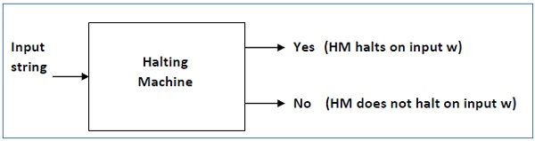
Halting Machine
KJSCE

Slide 35
inverted halting machine (HM)
Now we will design an inverted halting machine (HM)’ as −
If H returns YES, then loop forever.
If H returns NO, then halt.
The following is the block diagram of an ‘Inverted halting machine’ −
KJSCE

Slide 36
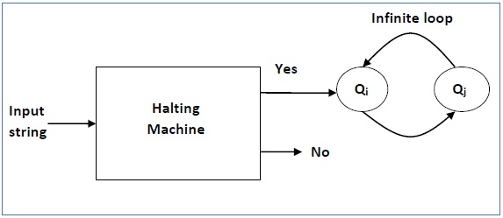
Inverted Halting Machine
KJSCE

Slide 37
Halting Problem is Undecidable
Further, a machine (HM)₂ which input itself is constructed as follows −
If (HM)₂ halts on input, loop forever.
Else, halt.
Here, we have got a contradiction. Hence, the halting problem is undecidable.
KJSCE

Slide 38
Halting Problem
Define a procedure halts? that takes a procedure and an input evaluates to #t if the procedure would terminate on that input, and to #f if would not terminate.
(define (halts? procedure input) … )
KJSCE

Slide 39
Examples
> (halts? ‘(lambda (x) (+ x x)) 3)
#t
> (halts? ‘(lambda (x)
(define (f x) (f x)) (f x))
27)
#f
KJSCE

Slide 40
Halting Examples
> (halts? `(lambda (x)
(define (fact n)
(if (= n 1) 1 (* n (fact (- n 1)))))
(fact x))
7)
#t
> (halts? `(lambda (x)
(define (fact n)
(if (= n 1) 1 (* n (fact (- n 1)))))
(fact x))
0)
#f
KJSCE

Slide 41
Can we define halts??
We could try for a really long time, get something to work for simple examples, but could we solve the problem – make it work for all possible inputs?
Could we compute find-proof if we had halts?
KJSCE

Slide 42
find-proof
I cheated a little here –
we only know we can’t
do this for “true”.
(define (find-proof S axioms rules)
;; If S is provable, evaluates to a proof of S.
;; Otherwise, evaluates to #f.
(if (halts? find-proof-exhaustive
S axioms rules))
(find-proof-exhaustive S axioms rules)
#f))
Where (find-proof-exhaustive S axioms rules) is a procedure that tries all possible proofs starting from the axioms that evaluates to a proof if it finds one, and keeps working if it doesn’t.
KJSCE

Slide 43
Another Informal Proof
(define (contradict-halts x)
(if (halts? contradict-halts null)
(loop-forever)
#t))
If contradict-halts halts, the if test is true and
it evaluates to (loop-forever) - it doesn’t halt!
If contradict-halts doesn’t halt, the if test if false,
and it evaluates to #t. It halts!
KJSCE

Slide 44
Russell’s Paradox
This should remind you of…
S: set of all sets that are not members of themselves
Is S a member of itself?
  If S is an element of S, then S is a member of itself and should not be in S.
  If S is not an element of S, then S is not a member of itself, and should be in S.
KJSCE

Slide 45
Undecidable Problems
If solving a problem P would allow us to solve the halting problem, then P is undecidable – there is no solution to P, since we have proved there is no solution to the halting problem!
There are lots of practical problems like this.
Example: why virus detectors will never really work!
KJSCE

